Slide 1

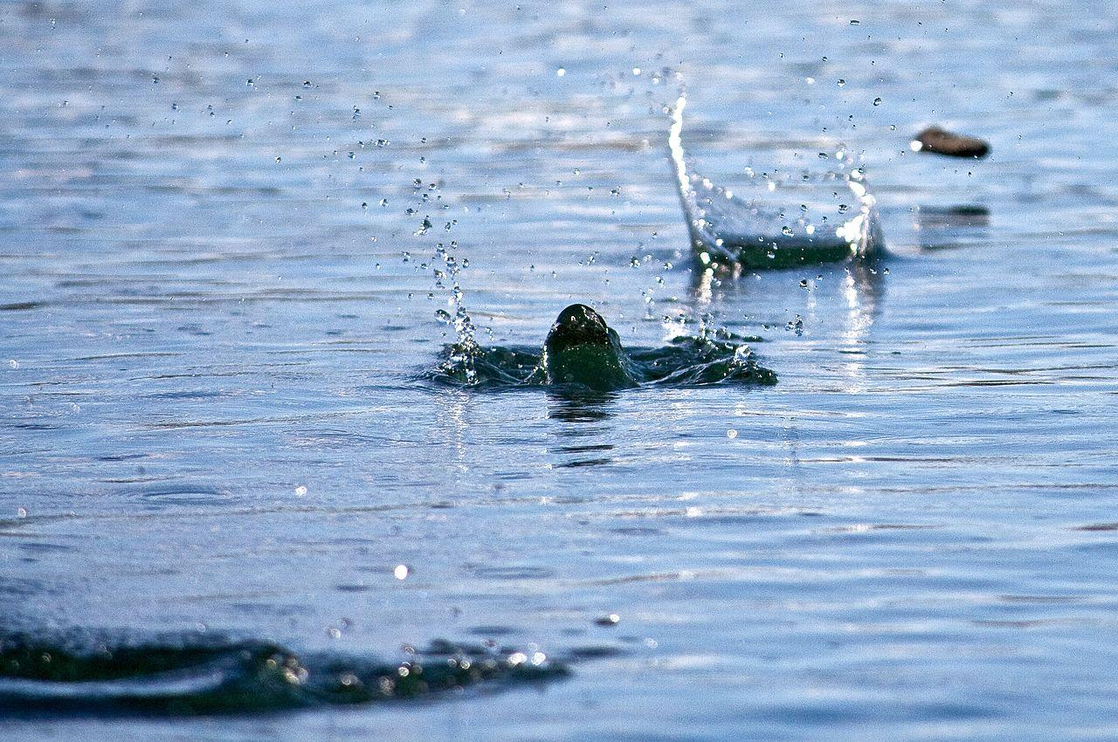
Game : Skip the Rock
Nixon Nelson & Lokesh Kumar S
Group 7

Slide 2

SKIP THE ROCK
AGENDA
GAME DESCRIPTION
ASSET DESCRIPTION
IDEATION
ASSET LIST
ART STYLES
COLOR PALLET

Slide 3
Skip the Rock
Brief: The player will have to skip the rock through a lake the rock as the rock goes farther it hits different objects gaining the player points.
Genre: Hypercasual, Arcade (12 % market share)
Objective: The player has to throw the rock as far as possible and it should skip on as many objects as possible.
Difficulty & Progress: The only difficulty in the game is to select the power of the throw in the given time and the no of skips handled by the direction of the throw. The rock will progress through different objects there will power ups to help it skip more easily on different objects.
Game Details:
Orientation: landscape
Monetization: Free to play shows ads in game for free power ups and buy different power ups using different categories of objects.eg frogs , trees and posts ,etc.
Controls: tap on the power meter to decide the power of the throw, left or right to change the direction of the throw.

Slide 4
Asset list:
The player character, the house, the different objects and living things, the rock and the environment.
Important Mechanics:
MVP: power meter and rock movement.
Oscillating power meter , Throwing action of the player , rock skipping on objects , Power ups are conditional based on the objects the rock skips on. Velocity increase in on certain objects.
WOW moments:
On level completion the rock comes through the window of a house and hits something interesting, displaying the score.
If the rock skips on same object multiple times the rock gains additional velocity.
Reference: https://play.google.com/store/apps/details?id=com.miniplay.gunspin&hl=en&gl=US
Ads:
Menu ads
power up giving ads
Future Scope: different modes , different power ups and characteristics to the rock.

Slide 5
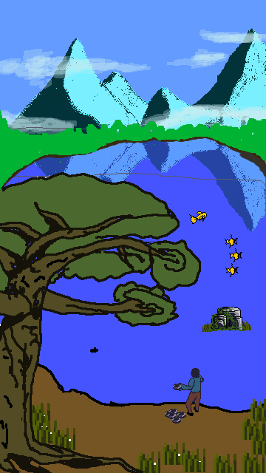

IDEATION
An glimpse of the game set up.
Viewing of the game can have multiple camera angles.
Game concepts and levels can be added as required.
The game can be designed for future concepts to be added.

Slide 6















ASSET LIST
ROCK SET
STONES
PLAYER
FROG

Slide 7





ASSETS
FISHES
RIVER/STREAM
ENERGY METER

Slide 8
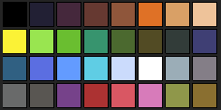
COLOUR PALLET
The different shades of colours used to create
the assets for the game.

Slide 9


